Slide 1
INVENTORY MANAGEMENT SYSTEM
GROUP :- 6

Slide 2
Team members
Employee Id | Name
2492317 | Prathipati Tulasi Sai Pavan
2491880 | Pratik Paul
2492272 | Ravikant X (Team leader)
2491916 | Rishabh Pahariya
2491672 | Sandeepti Kumar Khatua
2492082 | Saurav Ramakant Tayade
2491806 | Shaik Maroof
2492097 | Shruti Shashikant Meshram
2493115 | Shubham Awadhiya
2491826 | Shubham Jatav

Slide 3
Frontend Team Backend Team
Prathipati Tulasi Sai Pavan
Sandeepti Kumar Khatua
Shruti Shashikant Meshram
Rishabh Pahariya
Shaik Maroof
Ravikant X
Saurav Ramakant Tayade
Shubham Awadhiya
Shubham Jatav
Pratik Paul

Slide 4
INDEX
INTRODUCTION
PROJECT OVERVIEW
INVENTORY
INVENTORY MANAGEMENT
TECHNOLOGIES USED
MODULES
ADVANTAGES
FUTURE IMPLEMENTAION
CONCLUSION

Slide 5
INTRODUCTION
An inventory management system project that allows user to manage and maintain his/her inventory with ease.
The inventory management system has been developed to allow users to add an inventory, delete an inventory, enter inventory quantity and other details, update inventory status and more.

Slide 6
Inventory management tries to efficiently streamline inventories to avoid both gluts and shortages.
It also records the stock currently available in the store.

Slide 7
PROJECT OVERVIEW
This Inventory management system is all about selling and buying products.
It is a simple project that monitors the stock quantity. This system has a pleasant user interface,and it is user-friendly.
The system generates reports for the list of Items, Sales, Vendor, Customer, and Purchases.

Slide 8
INVENTORY
Inventory is a complete list of items such as property, goods in stock.
It is also used for a list of the contents of a household.
Inventory or stock refers to the goods and materials that a business holds for the ultimate goal of resale, production or utilization.

Slide 9
INVENTORY MANAGEMENT
inventory management is the function of understanding the stock mix of a company and the different demands on that stock.
Inventory management helps companies identify which and how much stock to order at what time. It tracks inventory from purchase to the sale of goods.
Inventory management is important for every other business enterprise.

Slide 10
Front end: Angular Server Side: Spring Boot Back-end: Hibernate, MYSQL Server: Tomcat
TECHNOLOGIES USED

Slide 11
Modules
1.User Registration
2.User Login
3.Item Management
4.Purchases Management
5.Sales Management
6.Customer Management

Slide 12
ADMIN MODULE
Login to portal.
Create Admin Account.
Logout.

Slide 13
USER MODULE
Register to the application.
Sign in to the application to maintain the record of activities.
Search for item by giving item number and item name.
Check the total stock of the item.
Check the sale details.
Fill the customer details by giving name, phone number and address.

Slide 14
REGISTER MODULE
FIELD REQUIRED :
Name
Username
Password
REST API’S :
login
register
reset password
clear

Slide 15
LOGIN MODULE
FIELD REQUIRED :
username
password
REST API’S :
add
remove

Slide 16
ITEM MODULE
FIELD REQUIRED :
item number
product id
item name
description
discount%
quantity
unit price
total stock
REST API’S :
add
update
delete
clear

Slide 17
PURCHASE MODULE
FIELD REQUIRED :
item number
item name
purchase date
purchase id
current stock
vendor name
quantity
unit price
total cost
REST API’S :
add
update
clear

Slide 18
SALE MODULE
FIELD REQUIRED :
item number
item name
customer name
customer id
sale id
sale date
total stock
discount%
quantity
unit price
total
REST API’S :
add
update
clear

Slide 19
CUSTOMER MODULE
FIELD REQUIRED :
name
customer id
phone(mobile)
phone 2
email
address
city
district
REST API’S PERFORMED :
add
update
delete
clear

Slide 20
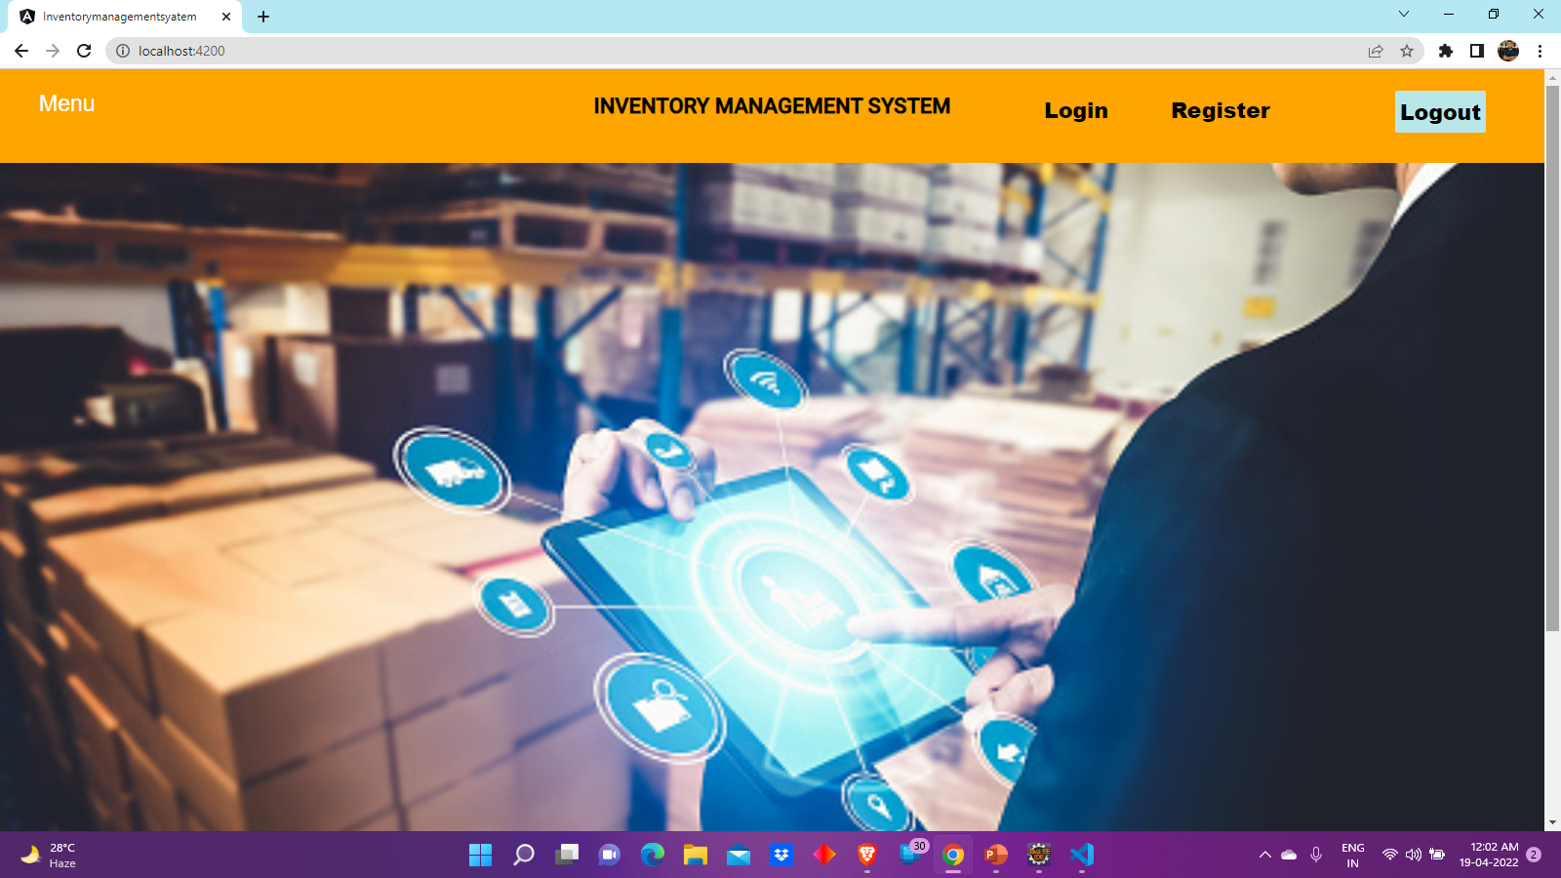

Slide 21
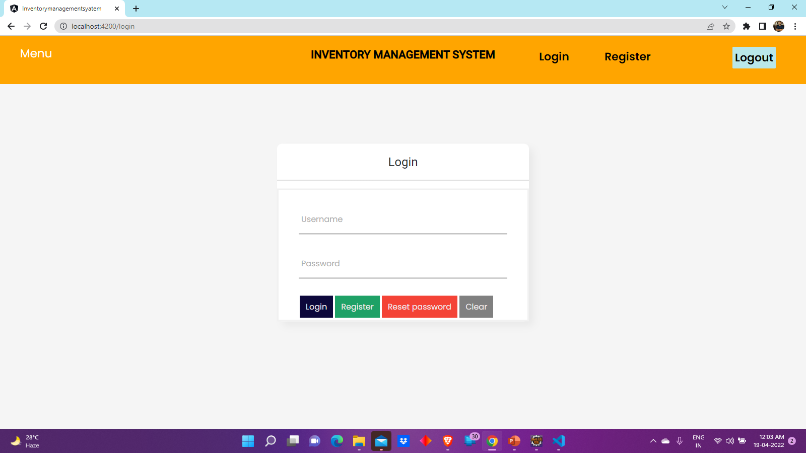

Slide 22
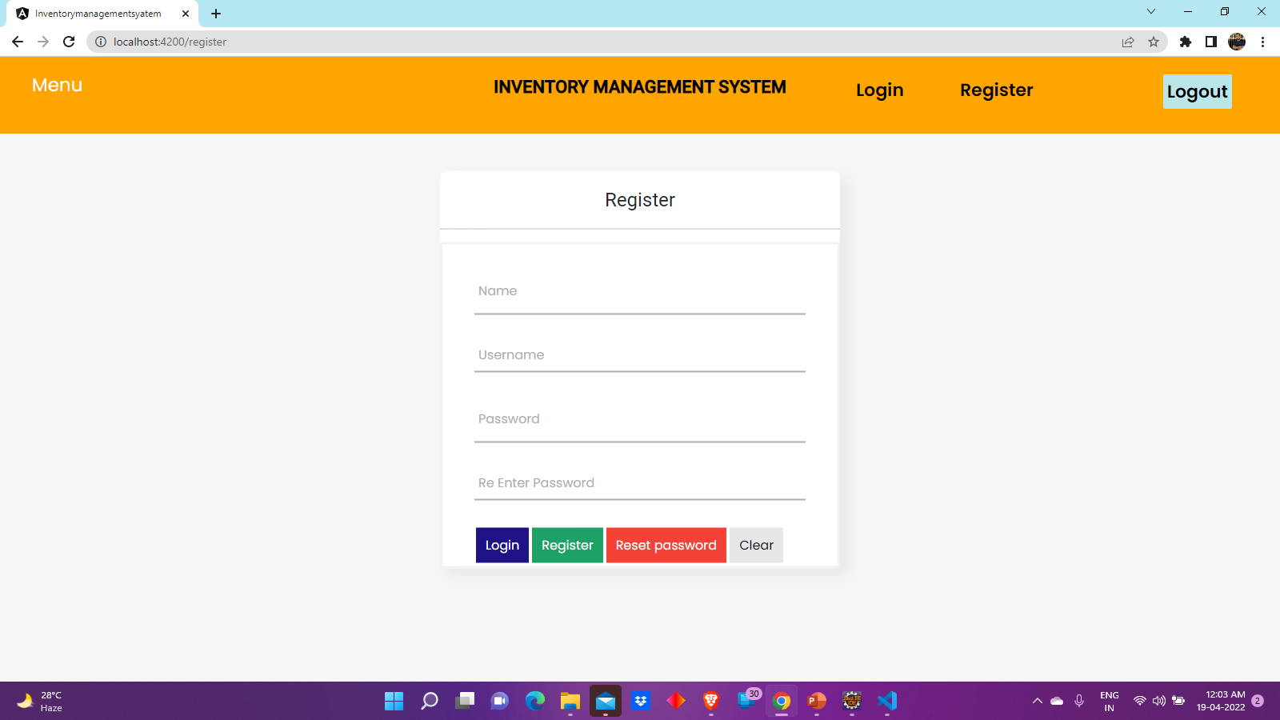

Slide 23
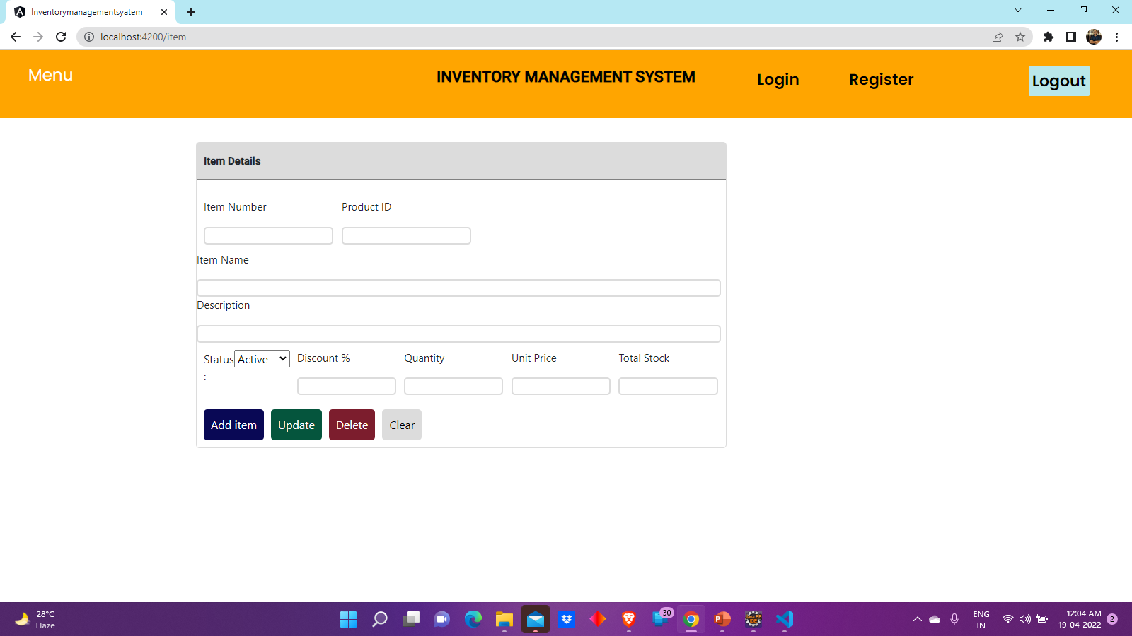

Slide 24
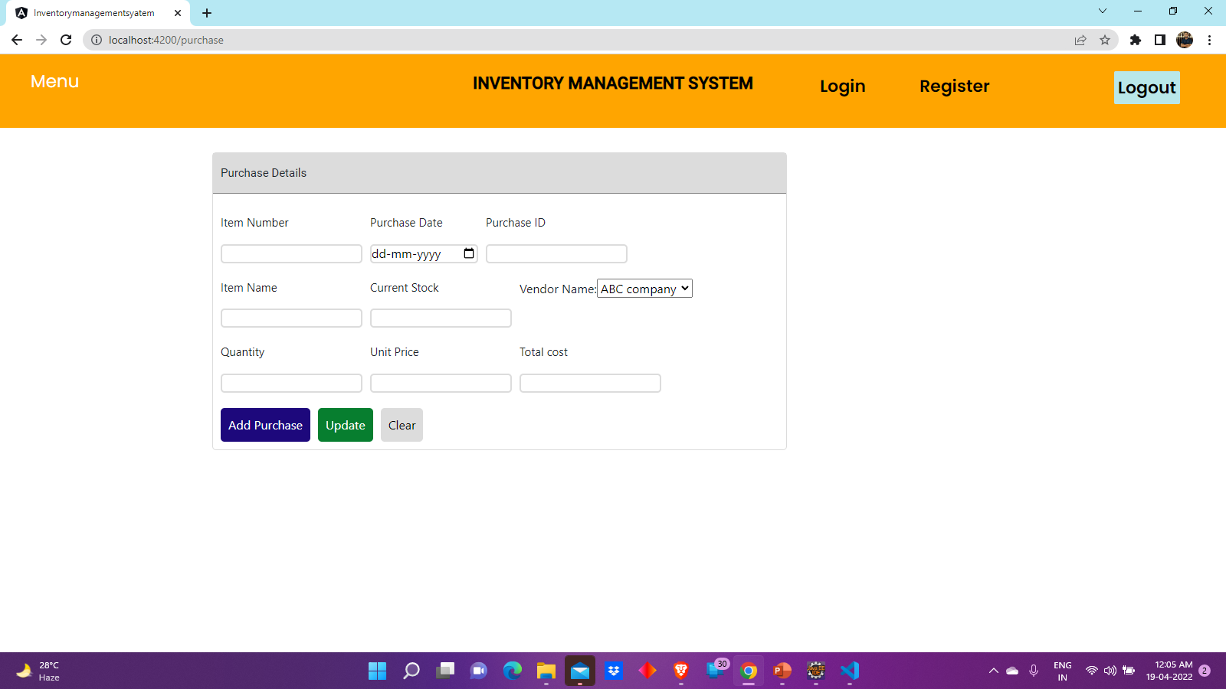

Slide 25
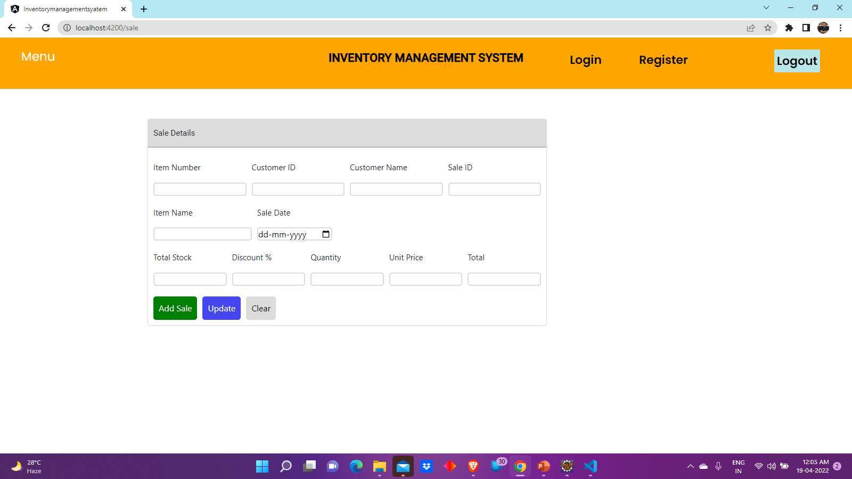

Slide 26
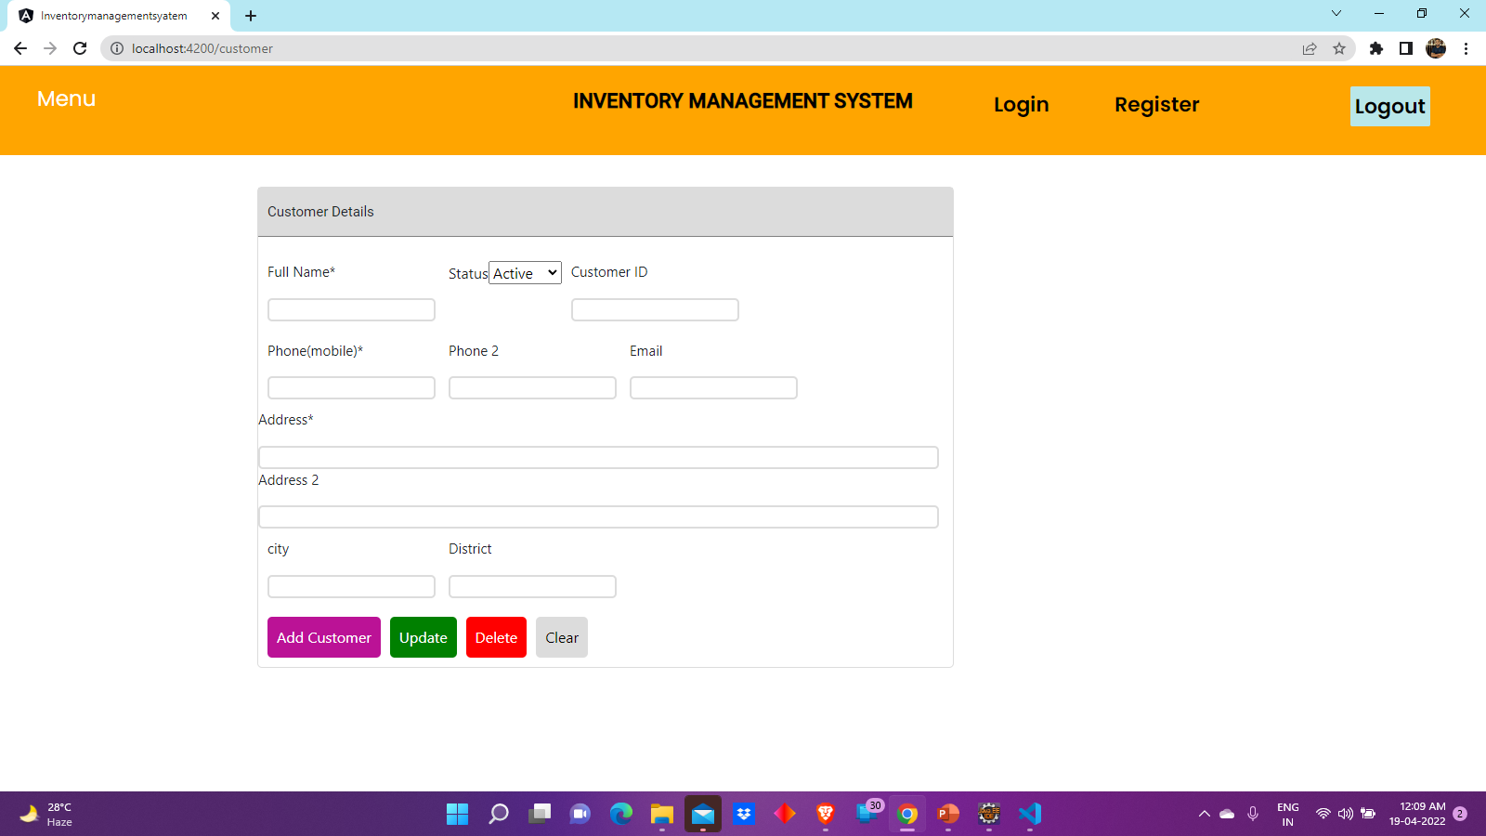

Slide 27
ADVANTAGES
It Reduces Risk of Overselling.
Avoiding Stockouts and Excess Stock.
A More Organized Warehouse.
Better Customer Experience

Slide 28
FUTURE IMPLEMENTATION
We can add some more features in future.
We can take feedbacks from the Customers to improve the Customer relationship.
Successful companies will view inventory as a strategic asset, rather than an aggravating expense or an evil to be tolerated.

Slide 29
CONCLUSION
Inventory management is important for keeping costs down, while meeting regulations.
Supply and demand is a delicate balance, and inventory management hopes to ensure that the balance undistributed.

Slide 30
THANK YOU

